Slide 2







17 Oct 2016 – 31 Oct 2016
2 weeks
1%
User Access (Login)
Content Customization
Visitor Check-in
Checkout
PROGRESS
SPRINT PERIOD
UPCOMING MEETINGS
UPCOMING EVENTS
User Testing
31 Oct 2016, Monday
Acceptance
7 Nov 2016, Monday
Internal
24 Oct 2016, Monday
31 Oct 2016, Monday
Client
Supervisor

Slide 3
The Project

Slide 4
Proposal
(17 Oct 2016
Acceptance
(7 Nov 2016)
Midterm
(20 Feb 2017)
Poster Submission
(27 Mar 2017)
Final Presentation
(10 Apr 2017)
Poster Day
(21 Apr 2017)
Milestones
Notes:
1e313e
Dbe9f9

Slide 5
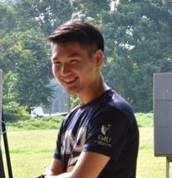
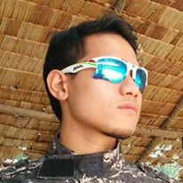
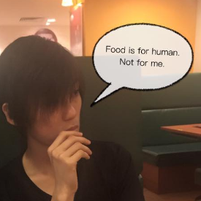

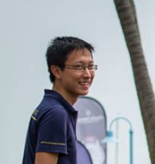
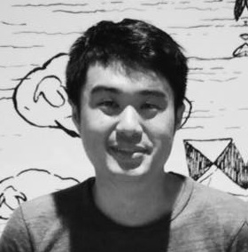

Slide 11
dbe9f9
 | #D2E0F0
 | #C8D7E6
 | #BFCDDD
 | #B5C4D4
 | #ACBBCA
 | #A2B2C1
 | #99A9B8
 | #8F9FAE
 | #8696A5
 | #7C8D9C
 | #738492
 | #6A7B89
 | #60717F
 | #576876
 | #4D5F6D
 | #445663
 | #3A4D5A
 | #314351
 | #273A47
 | #1e313e

